Slide 1
Photospheric X-ray Spectroscopy of Neutron Stars
Frits Paerels
Columbia University, NY, and
SRON National Institute for Space Research,
The Netherlands
Санкт-Петербург, 23-5-2008

Slide 2
Neutron Star Masses and Radii, 1932 - …
“M = 1.5 M_{O}, R = 10 km”

Slide 3
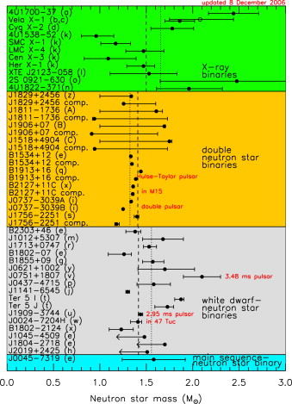
Mass Measurements
From: Lattimer & Prakash, 2007, Physics Reports, 442, 109

Slide 4
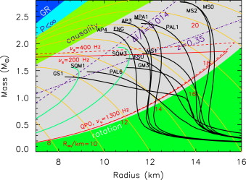
Masses and Radii; Equation of State
Limits from fundamental considerations (c_{s} < c, etc.); Spin rate;
soon: moment of inertia from precession of S in binary
From: Lattimer & Prakash, 2007

Slide 5
Attempts to use photospheric (X-ray) emission
Example: photospheric emission from PSR B0656+14
(from Finley, Ögelman, Kızıloğlu, 1992, Ap. J. (Letters), 394, L21)

Slide 6
To measure radius: need distance !
At low resolution and/or S/N: cannot measure intrinsic spectral shape
(everything looks like black body!)
Data from TENMA (proportional counter)
(from Waki et al., 1984, PASJ, 36, 819)

Slide 7
Potential of stellar photospheric spectroscopy
atomic absorption: T_{eff}, abundances, B, rotation;
NS: gravitational redshift!
X-ray burst spectrum:
bright, probably low B, freshly accreting metals
complements study of INS (high B, probably pure H or He)

Slide 8
Stark spectroscopy in Neutron Stars
Pressure broadening should be observable!
Hydrogenic ion (for simplicity):
linear Stark effect: ΔE = 3a₀|E|/Z
(E perturbing electric field, Z nuclear charge, a₀: Bohr radius
dimensionally: ΔE ~ p•E )
so
characteristic density: from integrating hydrostatic eq. down to τ_{T} = 1:

Slide 9
The Stark width is not small!
So for O VIII Lyα (853 eV): ΔE/E = 1/40!
Higher order series members even more broadened:
absorption spectrum strongly density-sensitive
Stark broadening dominates over wide range of conditions:
thermal Doppler:
rotation: ΔE/E ≤ 1/40 for P_{rot} ≥ 8 msec (R = 10 km)
B-fields: ΔE_{Zeeman} < ΔE_{Stark}: ΔE_{Zeeman} = μ_{B} |B| < 20 eV: |B| < 3 x 10⁹ G
STARK WIDTH IS SENSITIVE TO DENSITY, HENCE TO g = GM/R²;
COMBINE WITH REDSHIFT (M/R): GET MASS AND RADIUS!

Slide 10
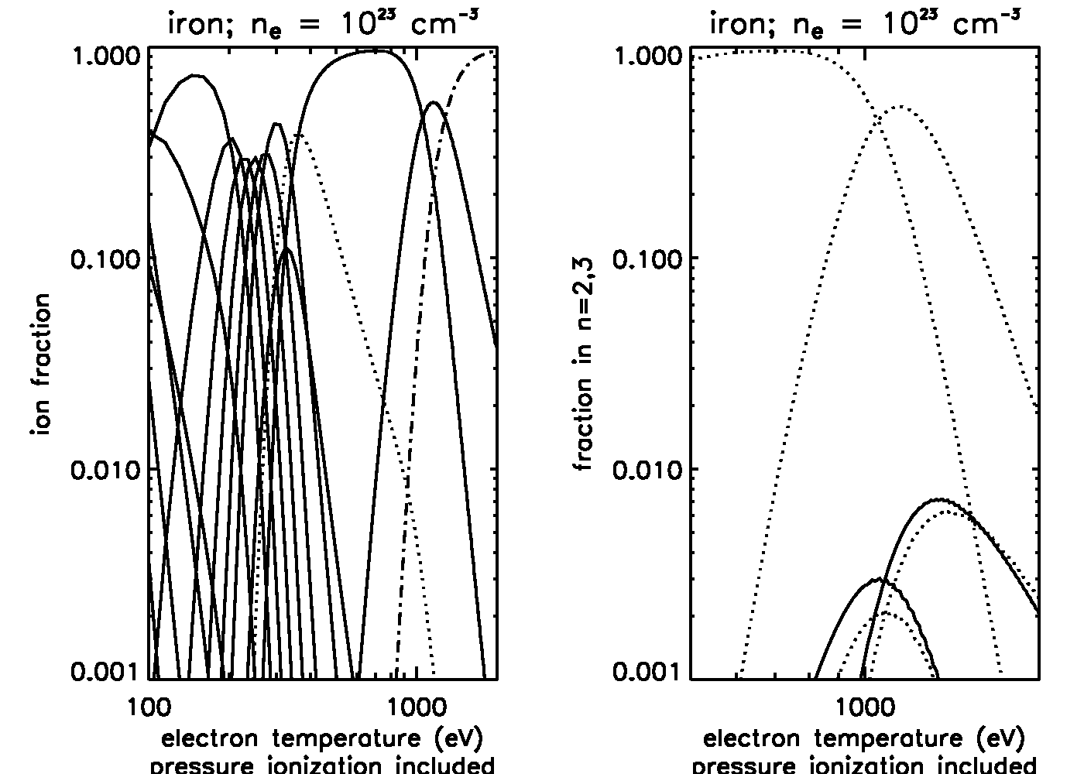
But will there be any bound electrons?
Saha/Boltzmann for NS densities at high temperature:

Slide 11
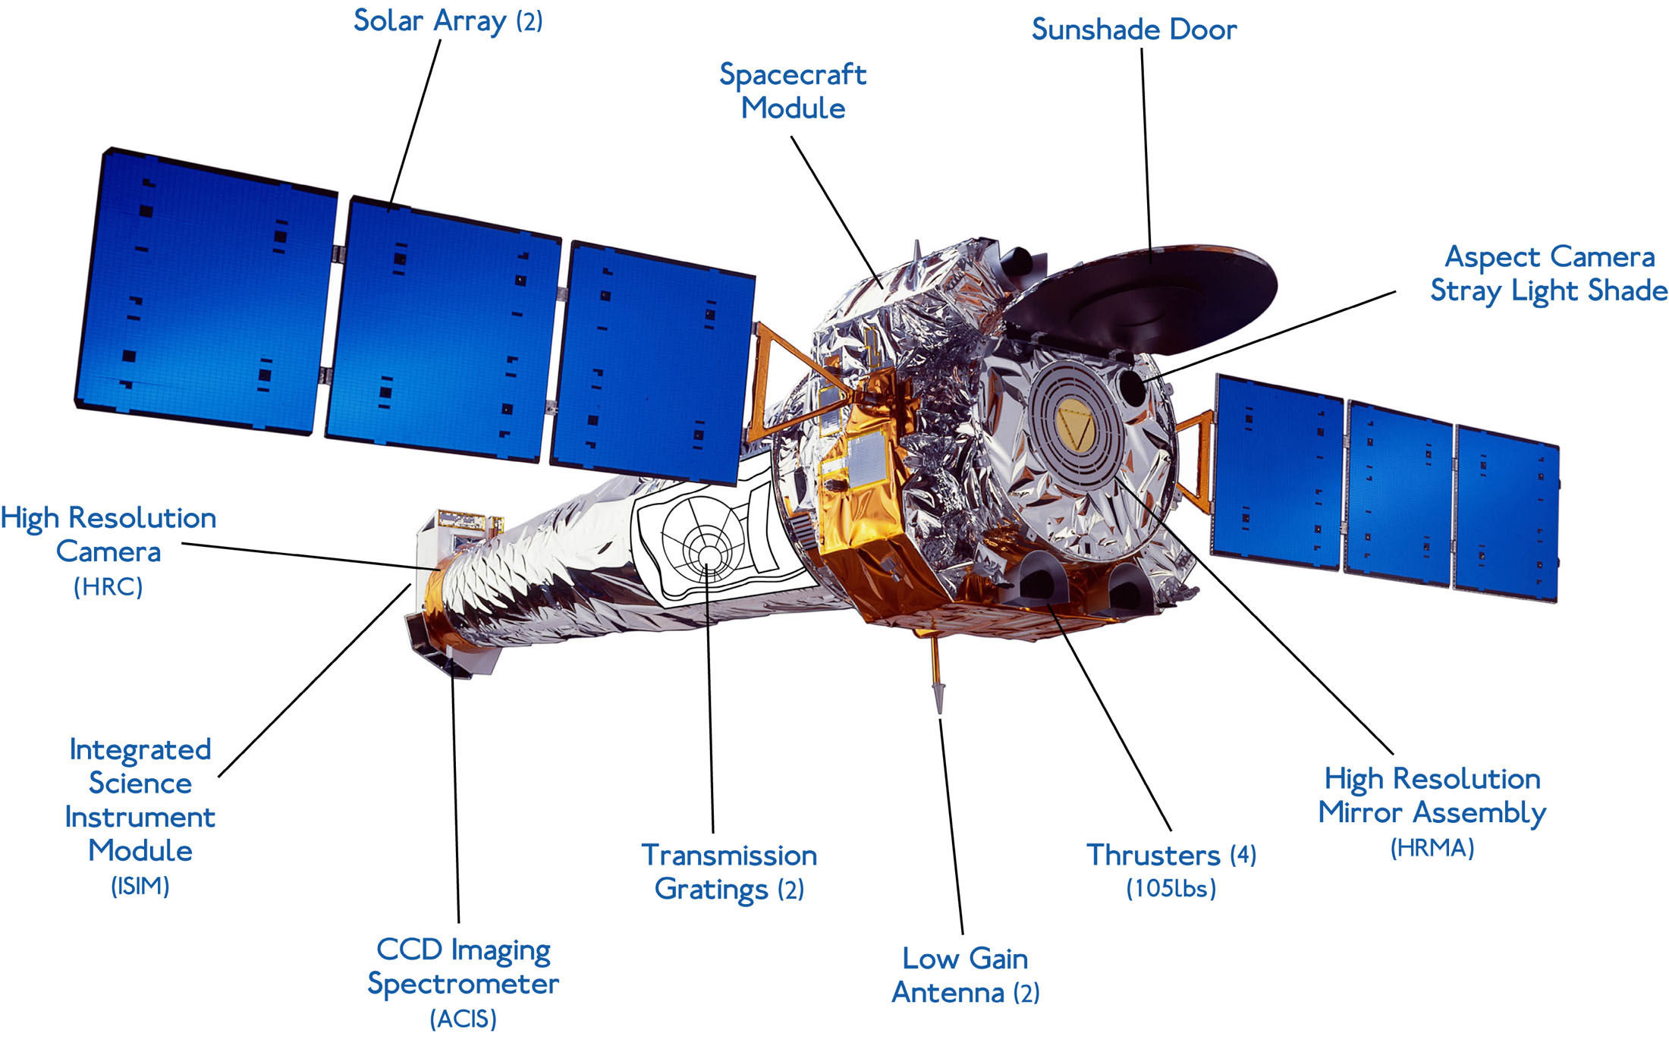
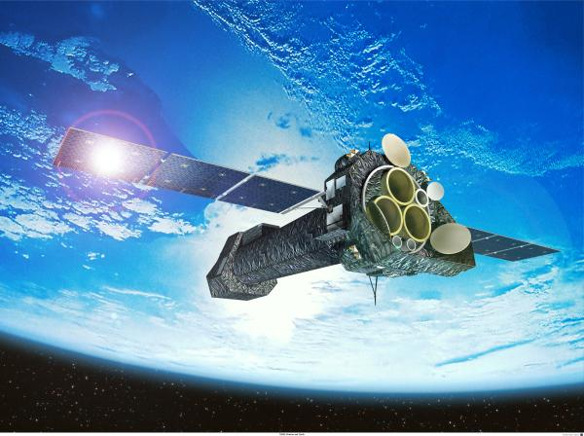
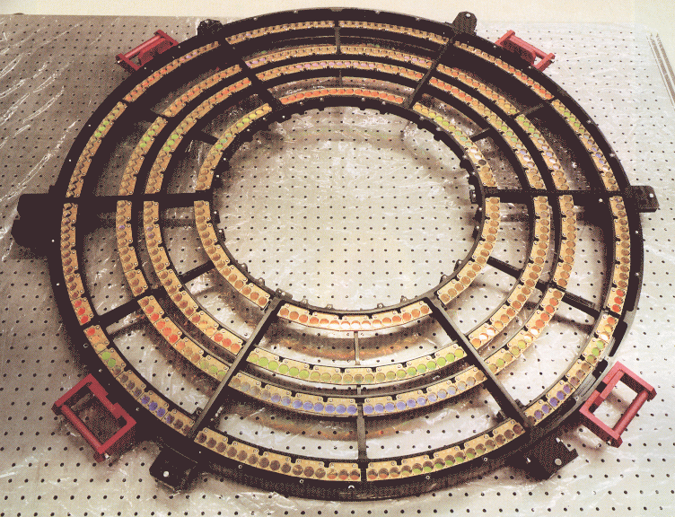
High Resolution Photospheric Spectroscopy:
the grating spectrometers on Chandra and XMM-Newton

Slide 12
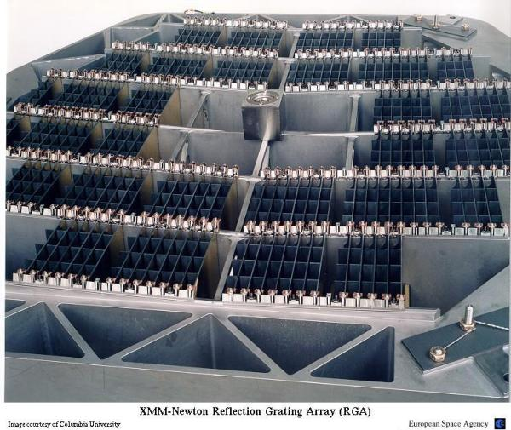
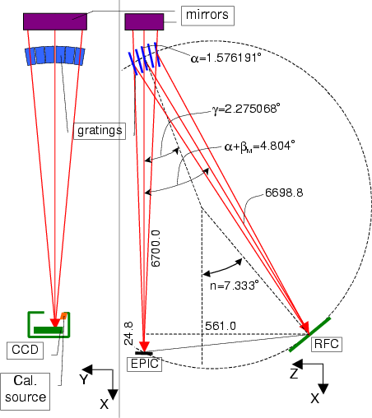
Resolving powers:
Chandra HETGS: 0.5-8 keV, E/ΔE up to ~ 1000
(Chandra LETGS:0.08-2 keV, E/ΔE up to ~ 2000)
XMM-Newton RGS: 0.3-2 keV, E/ΔE up to ~ 700

Slide 13
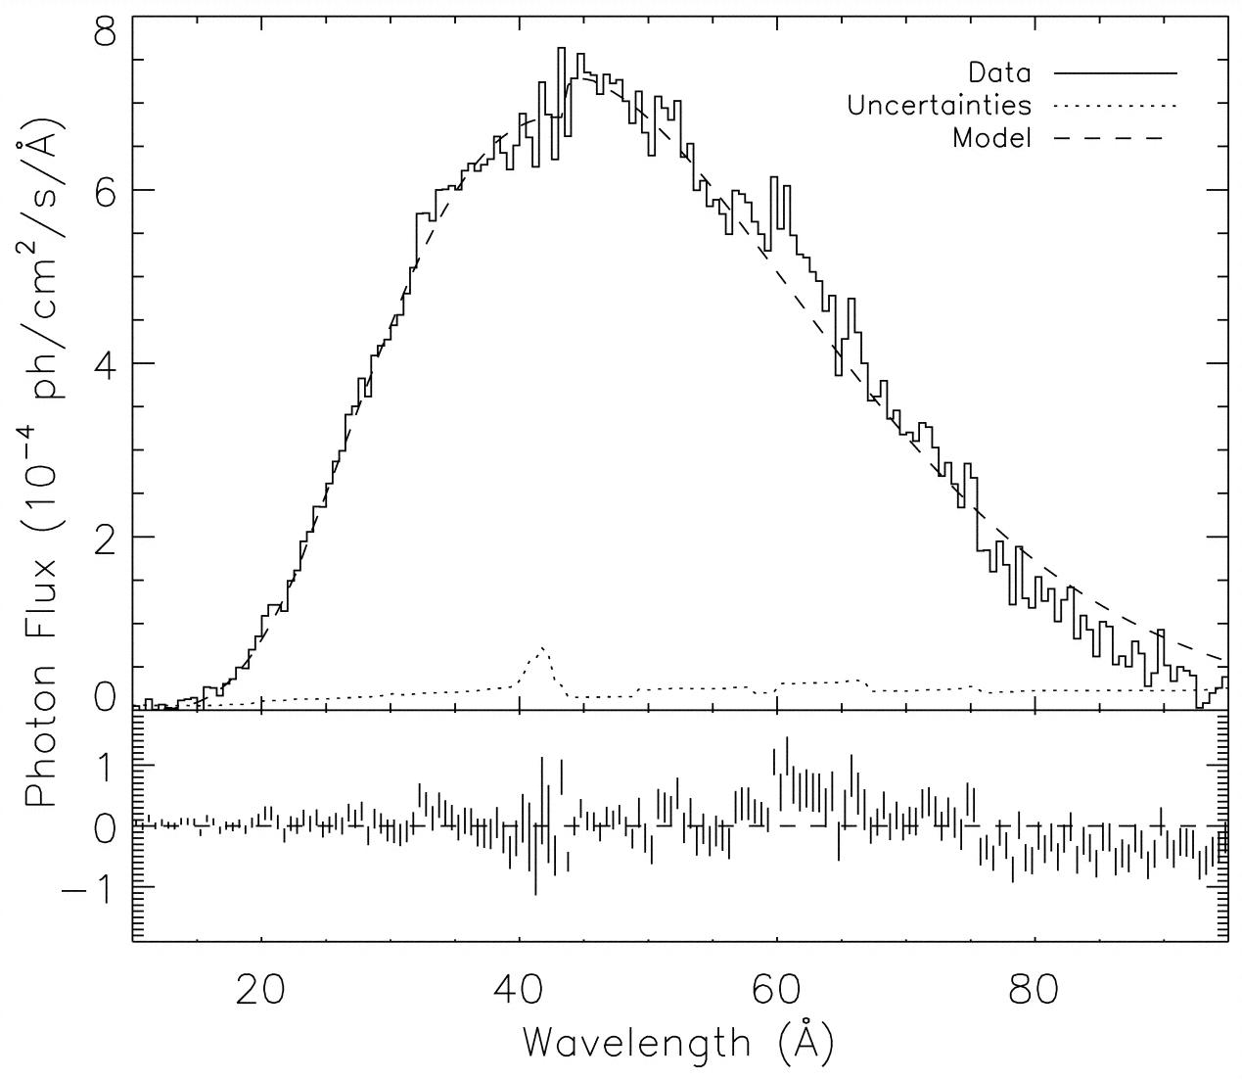
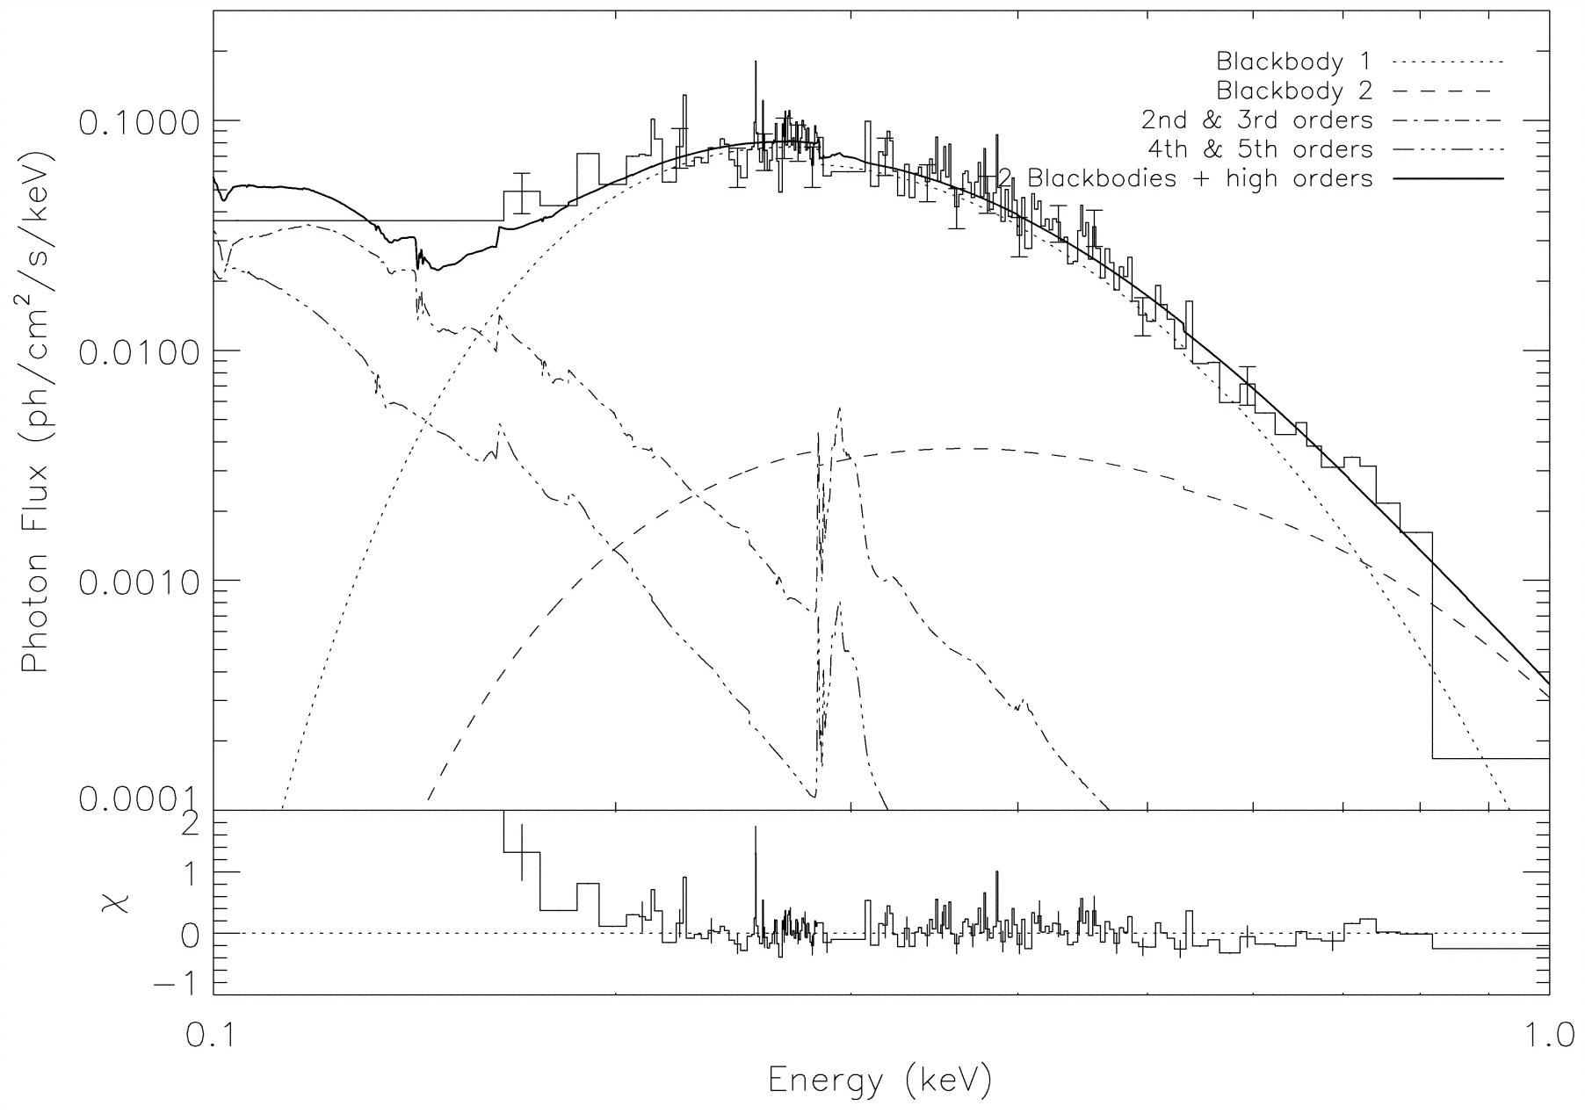
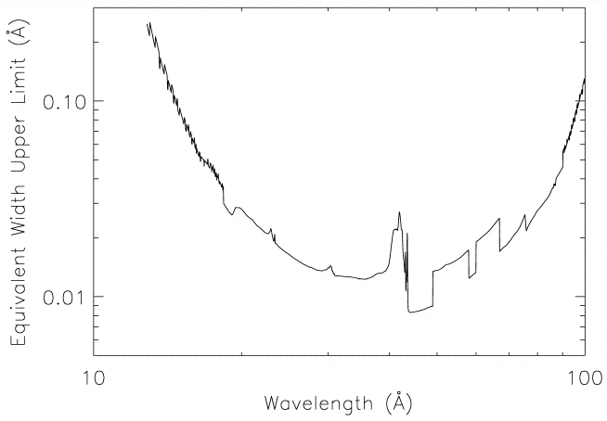
RX J1856.5-3754/ Chandra LETGS
(Drake et al., 2002, ApJ, 572, 996)
nearly 500 ksec exposure!
EW:
λ/Δλ up to
~3500!
PSR B0656+14/ Chandra LETGS
(Marshall & Schulz, 2002, ApJ, 574, 377)

Slide 14
How about the X-ray Burst Spectrum ?
EXO 0748-676/ EXOSAT ME 1985
LMXB EXO 0748-676 (Parmar et al. 1986, ApJ, 308, 199)
P = 3.82 hr; dips; edge-on; frequent bursts

Slide 15
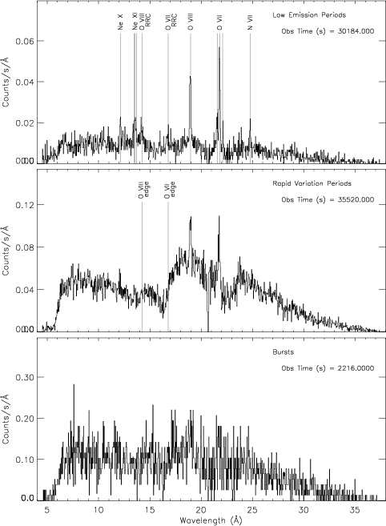
EXO 0748-676/ XMM-Newton RGS: 300 ksec serendipitous exposure during checkout
Emission/absorption from
accretion disk corona;
He, H-like ions of N, O, Ne
Direct disk emission
blocked; ADC visible
Disk shines through blocking
material
30 X-ray bursts

Slide 16
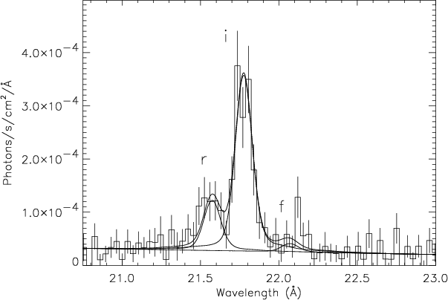
Intermezzo: spectroscopy of the photoionized gas in the disk corona
Gas is cool, photoionized:
detect narrow RRC;
OVII ‘triplet’:
i + f > r
i > f : collisional or radiative
pumping to I : high
density medium, or
strong UV field from
disk
very unusual spectrum!
He-like ion n=1,2

Slide 17
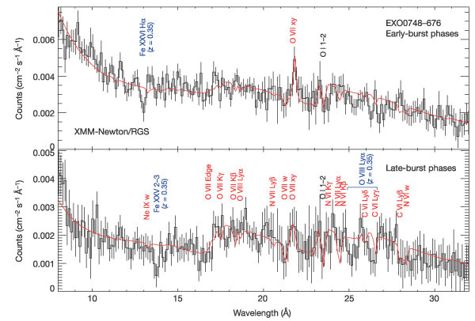
XMM/RGS: Cumulative spectrum of 30 X-ray bursts
If correct identification: gravitational redshift!
z = 0.35
(Cottam, Paerels, & Mendez, 2002, Nature, 420, 51)

Slide 18
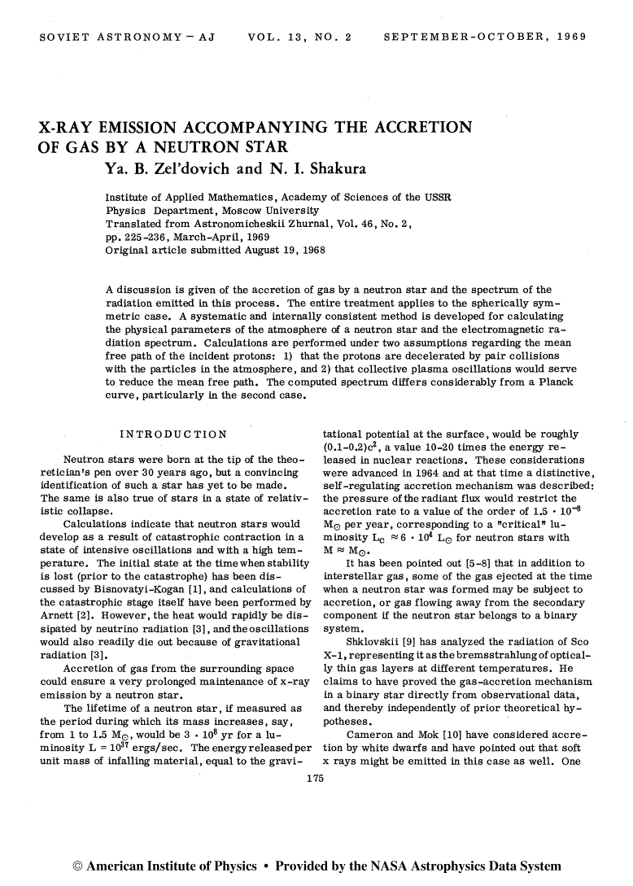
Irony: if z = 0.35 is correct, star is inside ISCO! accreting gas falls freely into
atmosphere- resulting spallation may have observable effects (e.g. appearance
of elements Z = 25, 24, 23, … )

Slide 19
Curve of growth for Fe XXVI n=2-3 (absorbing layer approximation)
Also: slow spin (fortuitous)!
ν = 45 Hz, Villareal & Strohmayer, 2004, ApJ, 614, L121

Slide 20
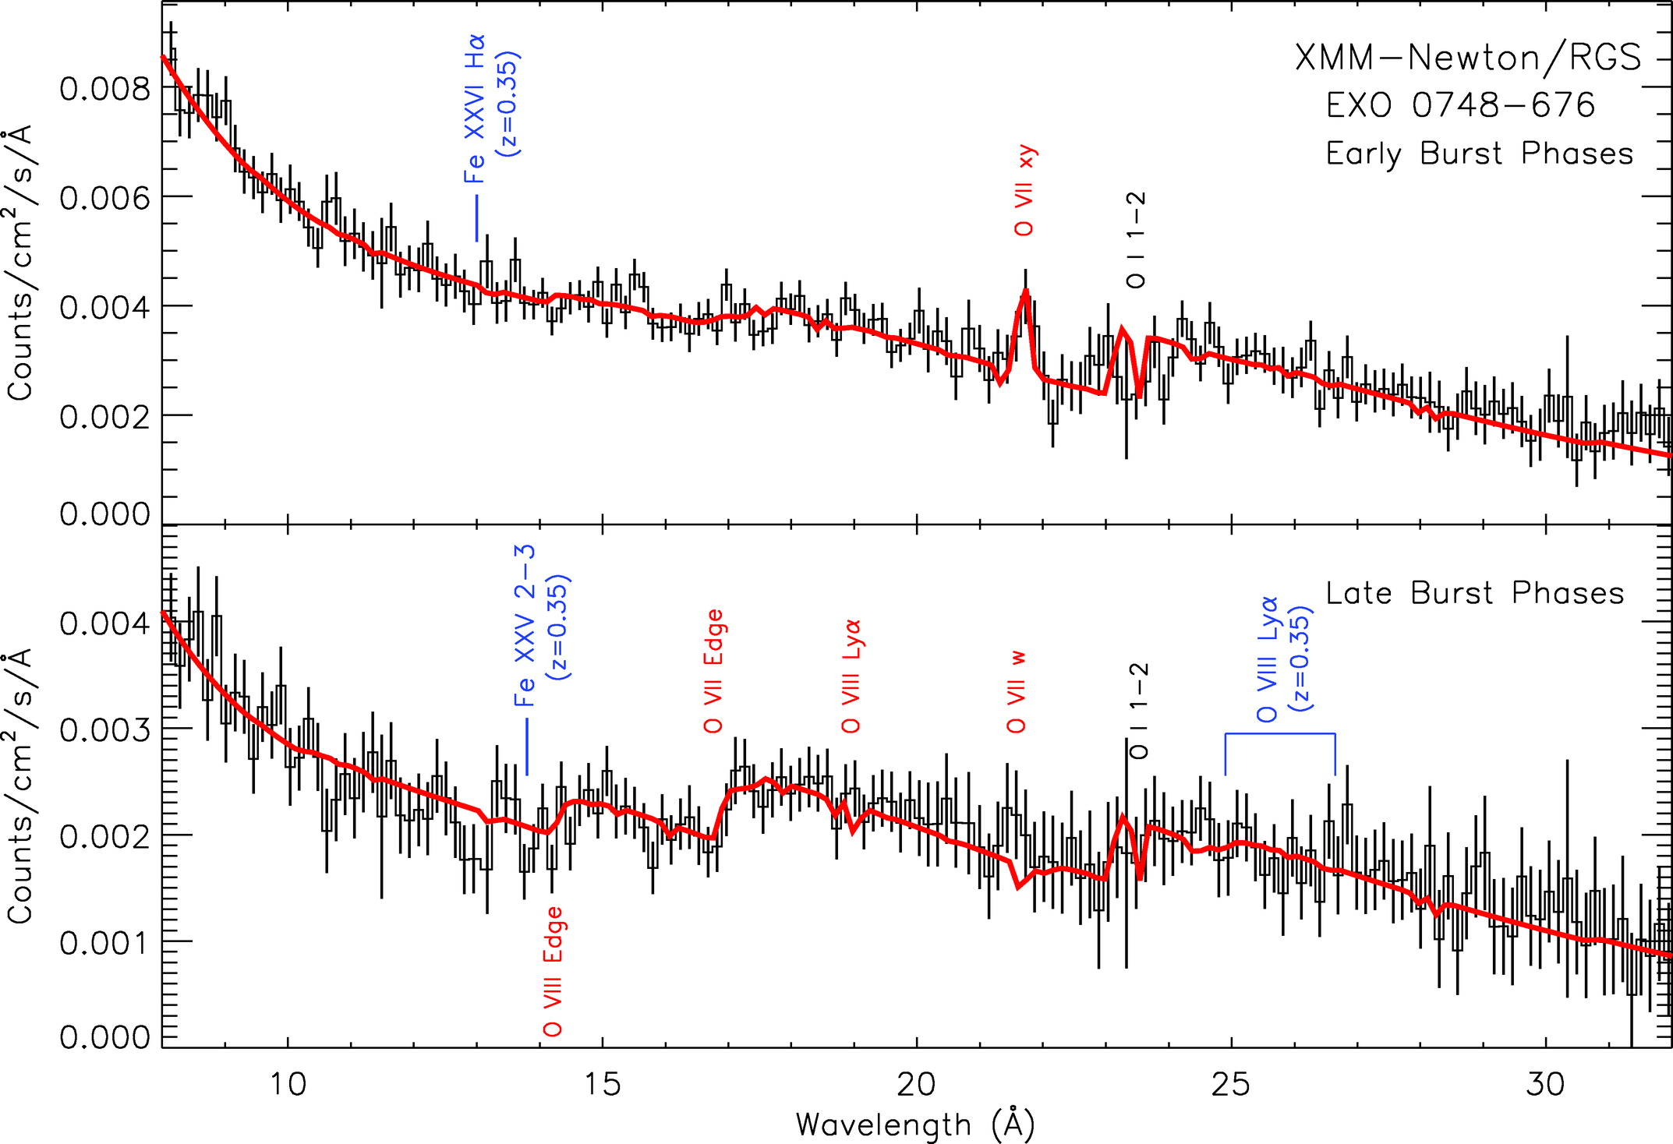
Attempt verification: reobservation of the Fe XVII Balmer band with XMM/RGS
(Cottam et al., 2008, ApJ, 672, 504)

Slide 21
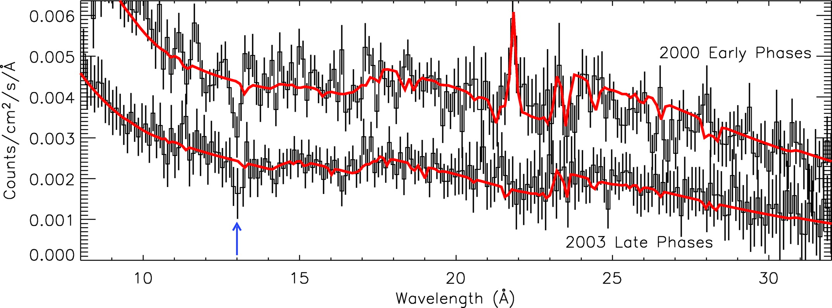
Compare to 2000 observation

Slide 22
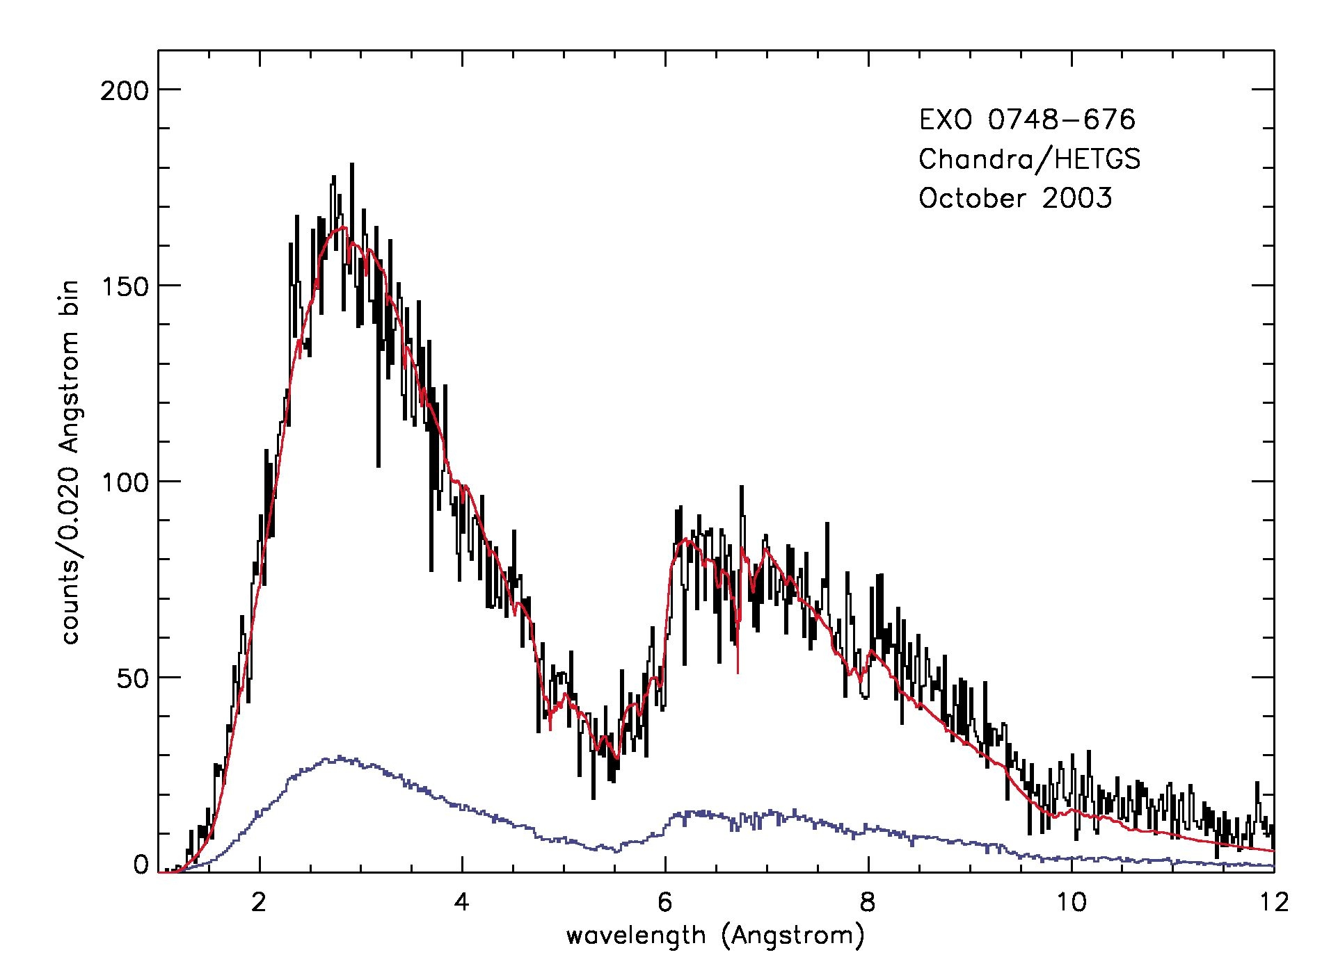
Attempt verification: search the Fe XVII Lyman band
37 X-ray bursts with Chandra HETGS; Paerels et al., in preparation.

Slide 23
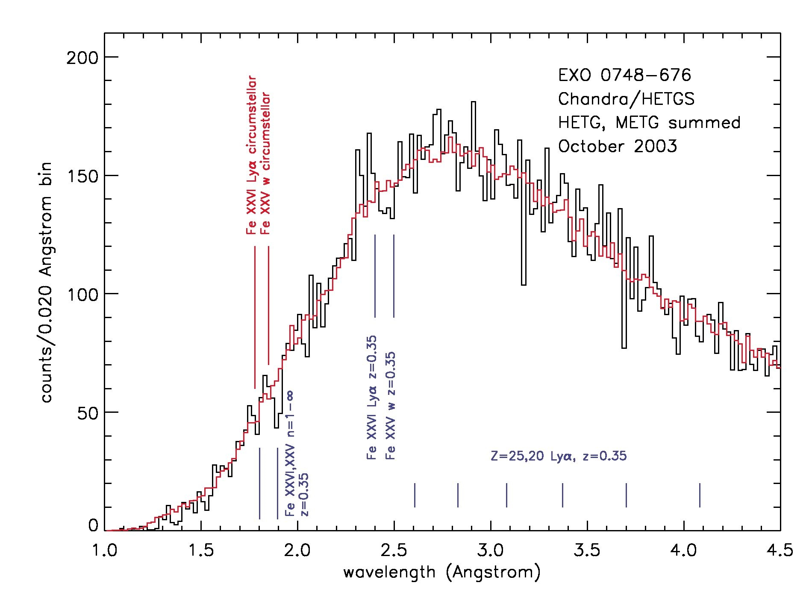

Slide 24
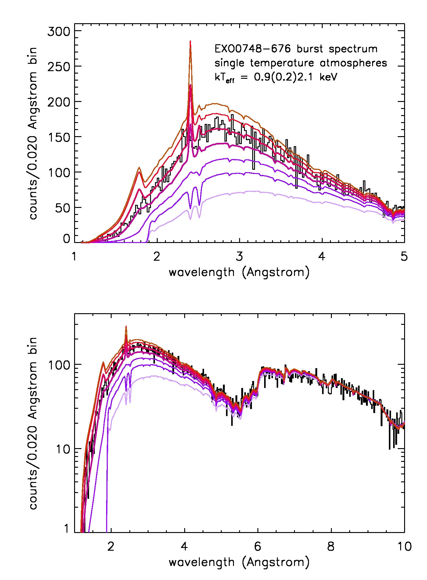

Slide 25
Need spectroscopically accurate models for the spectrum
Improvements needed:
Using TLUSTY NLTE model atmospheres code (Ivan Hubeny, Thierry Lanz)
NLTE important: Fe XXVI Lyα:
Need complete Fe atomic structure model; consider all transitions
Need model for Stark effect, pressure ionization: plasma-ion interaction,
probably very nonlinear (not a dilute plasma)
Want to model Lyman, Balmer, and Paschen (spectra exist!)

Slide 26
